Slide 1

CSCI-3753: Operating Systems Spring 2019
Anh Nguyen
Department of Computer Science
University of Colorado Boulder

Slide 2
Welcome to Operating Systems Recitation
Anh Nguyen
CS Ph.D. student
Work in Mobile & Network Systems Lab (MNS)
Research area: mobile healthcare
Email: Anh.TL.Nguyen@Colorado.EDU
Website:
http://mnslab.org/anhnguyen/courses/S19_3753_Rec.html

Slide 3
Welcome to Operating Systems Recitation
Office hours:
W 10:00AM – 11:30AM
F 12:00PM – 1:30PM
Location: ECCS 102
Available other times as needed, send me an email to schedule
Attendance might be taken at the TA's discretion.

Slide 4
Goals
Lectures
Concepts
General issues
Recitation
OS-specific concepts and examples
Linux environment
Detailed explanation of key algorithms, topics, etc. in lectures

Slide 5
Grading Policy
Recitation Quizzes
11 quizzes – drop ONE lowest score
Content?
From Monday and Wednesday and PREVIOUS Friday's lectures & corresponding book chapters
Time?
The last 10 minutes of the class
Method?
Online on Moodle → Bring your LAPTOP !!!
Grading?
10% of the final grade
Notes:
Be strict in the duration of opening the quiz on Moodle
Mention that both the person share the code and the person take the code while not in the class violate the code.

Slide 6
Grading Policy
Programming Assignment
4 – 5 assignments
Interview-style grading
20-40% working code
60-80% interview
The extra credit for early submission is 10% of the grade that you get.
min(100, actual grade * 1.1)
Highly encourage you to submit running programs that have partially completed functionality for partial credit !!!
Notes:
Interview:
- Question styles
- Bring the laptop to show the work on it or remotely via Teamviewer

Slide 7
Week 1: OS & Environment Setup

Slide 8
What is an Operating System?
Notes:
An operating system (OS) is system software that manages computer hardware and software resources and provides common services for computer programs.
Time-sharing operating systems schedule tasks for efficient use of the system and may also include accounting software for cost allocation of processor time, mass storage, printing, and other resources.

Slide 9
5 Main Managers Developed in an OS
Device manager
File system manager
Memory manager
Scheduler
Networking
Notes:
Process management. The OS must allocate resources to processes, enable processes to share and exchange information, protect the resources of each process from other processes and enable synchronization among processes.
A command interpreter is the part of a computer operating system that understands and executes commands that are entered interactively by a human being or from a program. In some operating systems, the command interpreter is called the shell.

Slide 10
Get Ready for Your Environment
Download CU CS Virtual Machine.
https://foundation.cs.colorado.edu/vm/
Two download options (HTTP and Torrent)
Download and install VMware hypervisor
Player/Workstation/Fusion.
You should have a CU VMware webstore account.
If not, contact help@cs.colorado.edu
Import CU CS VM to VMware
Notes:
Hypervisor = virtual machine manager (VMM)
Common questions
Can I use an old VM?
Can I use VirtualBox?
Can I use my own Linux distribution, my own VM?

Slide 11
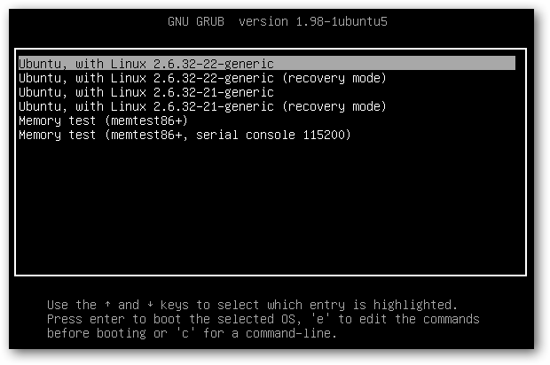
Loading an OS using Grub
Grub is a boot loader which provides configuration options to boot from a list of different kernels available on the machine.
Notes:
+ Bootstrap loader: small program

Slide 12
Configuring the Grub
Step 1: From the command line, load the grub configuration file:
sudo emacs /etc/default/grub
Step 2: Make the following changes to the configuration file:
Comment out (#):
GRUB_HIDDEN_TIMEOUT=0
GRUB_HIDDEN_TIMEOUT_QUIET=true
GRUB_CMDLINE_LINUX_DEFAULT="quiet splash"
Notes:
We will need to update our Grub configuration to allow booting from multiple kernel versions and to recover from a corrupt installation.
Emacs -> editor (nano, vi)

Slide 13
Configuring the Grub
Step 2: Make the following changes to the configuration file:
Add:
GRUB_CMDLINE_LINUX_DEFAULT=""
Save updates
Step 3: From the command line, update Grub:
sudo update-grub
Step 4: Reboot your virtual machine and verify you see a boot menu.

Slide 14
Preparations for PA1
The assignment will be released soon.
Goals
Compile a kernel
Add your own System Calls into the OS
What is a system call?
Examples: open(), read(), write(), close(), wait(), exec(), fork(), exit(), kill()
Snapshots function in VMware
Notes:
System call: a computer program requests a service from the kernel of the operating system it is executed on. (a way of communication between user space and kernel space)
The kernel is a computer program that is the core of a computer's operating system, with complete control over everything in the system.
+ fork(): a process creates a copy of itself
+ process (own resources) vs thread (share the same memory)
pwd -> /home/user
cd /proc -> virtual file system (active in memory but not stored in physical device
ls -> numbers = process ids
cd 1
sudo su
ls -> files showing information of particular process
cat cpuinfo -> 2 CPUs with 1 physical id -> 1 CPU 2 cores
cat meminfo
pop -> swap?
/proc folder, create a file, execute to communicate with kernel

Slide 15
Week 1 – Checklist
Self-enroll on Moodle
Have VMware setup ready
Have CU CS Virtual Machine Fall 2018 Ed. Installed
Read more about system calls

